Slide 1
CMP 2203
LECTURE 6

Slide 2
About me
Name: Catherine Namara - BSc. (EE) , MSc. (Project Planning & Management)
Email: catherine.namara@gmail.com

Slide 3
Encoders
Performs opposite function of a decoder. Encode given information into a more compact form.
Encoders are used to reduce the number of bits needed to represent given information. This is useful if information is to be stored for later use.
A practical use of encoders is for transmitting information in a digital system by allowing the transmission link to be built using fewer wires.
What are the practical applications of encoders in technology?
(Homework)
Two forms of encoders; binary and priority encoders

Slide 4
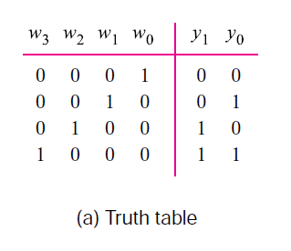
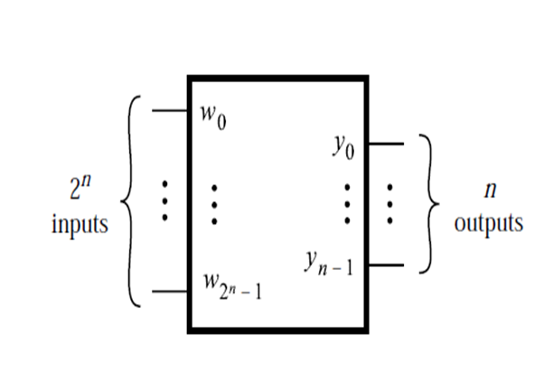
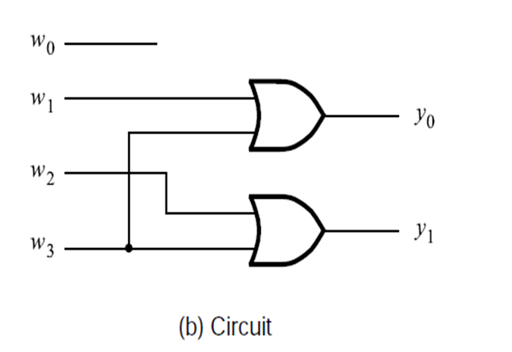
Binary encoders
a binary encoder, is a multi-input combinational logic circuit that converts the logic level “1” data at its inputs into an equivalent binary code at its output.
encodes information from 2n inputs into an n-bit code
digital encoders produce outputs of 2-bit, 3-bit or 4-bit codes depending upon the number of data input lines. An “n-bit” binary encoder has 2^{n} input lines and n-bitoutput lines with common types that include 4-to-2, 8-to-3 and 16-to-4 line configurations.
Source : Tocci

Slide 5
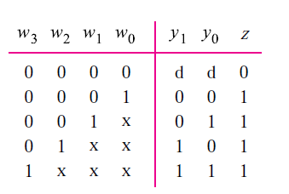
Priority Encoders
Priority encoder allocates a priority level to each input.
The priority encoders output corresponds to the currently active input which has the highest priority. So when an input with a higher priority is present, all other inputs with a lower priority will be ignored

Slide 6
Comparators
electronic device that takes two numbers as input in binary form and determines whether one number is greater than, less than or equal to the other number.
made up from standard AND, NOR and NOT gates that compare the digital signals present at their input terminals and produce an output depending upon the condition of those inputs.
Comparators are used in central processing units (CPUs) and microcontrollers (MCUs).
Examples of digital comparator include the CMOS 4063 and 4585 and the TTL 7485 and 74682.

Slide 7
Types of digital comparators
Identity Comparator – an Identity Comparator is a digital comparator with only one output terminal for when A = B, either A = B = 1 (HIGH) or A = B = 0 (LOW)
Magnitude Comparator – a Magnitude Comparator is a digital comparator which has three output terminals, one each for equality, A = B greater than, A > B and less than A < B
The purpose of a Digital Comparator is to compare a set of variables or unknown numbers, for example A (A1, A2, A3, …. An, etc) against that of a constant or unknown value such as B (B1, B2, B3, …. Bn, etc) and produce an output condition or flag depending upon the result of the comparison.

Slide 8
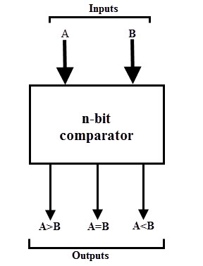
Example of a digital comparator
Three binary variables are used to indicate the outcome of the comparison as A>B, A<B, or A=B. The below figure shows the block diagram of a n-bit comparator which compares the two numbers of n-bit length and generates their relation between themselves.
These comparators can compare 2-bit, 4-bit and 8-bit numbers depending on the application requirement
Source : https://www.electronics-tutorials.

Slide 9
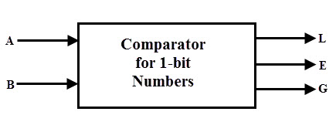
Single Bit Magnitude Comparator
used to compare two bits, i.e., two numbers each of single bit is called a single bit comparator. It consists of two inputs for allowing two single bit numbers and three outputs to generate less than, equal and greater than comparison outputs.
The figure shows the block diagram of a single bit magnitude comparator. This comparator compares the two bits and produces one of the 3 outputs as L (A<B), E (A=B) and G (A>B)
Source : https://www.electronics-tutorials.

Slide 10
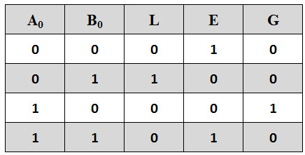
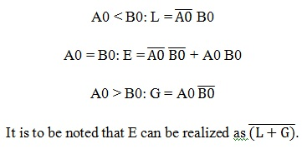
Single Bit Magnitude Comparator
The truth table for the single bit comparator is given below. When A0 B0 = 00 & 11, both inputs are equal, therefore A=B output will be high. When A0 B0 = 01, B is more than A and hence AB is active.
From the truth table logical expressions for each output can be expressed as

Slide 11
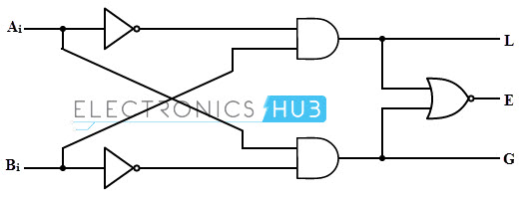
Single Bit Magnitude Comparator
By using these Boolean expressions, we can implement a logic circuit for this comparator using two AND gates, one NOT gate and one Ex-NOR gate as shown in below figure. AND gates are used to find whether a binary digit is less than greater than another bit whereas Ex-NOR gate is used to find whether two binary numbers are equal or not.
Source: Electronic Hub -https://www.electronicshub.org

Slide 12
Single Bit Magnitude Comparator
In the figure, one AND gate output is 1 if A0 > B0 (i.e., A0 =1 and B0 =0) and is zero if A0 < B0 (i.e., A0 =0 and B0 =1). Similarly, other AND gate output is one if A0 < B0 (i.e., A0 =0 and B0 =1) and is zero if A0 > B0 (i.e., A0 =1and B0 =0).
The Ex-NOR gate has inputs A0 B0, hence the output of the Ex-NOR gate will be 1 if A0 = B0 and the output will be 0 if A0 is not equal to B0.

Slide 13
Applications
used in the address decoding circuitry in computers and microprocessor based devices to select a specific input/output device for the storage of data.
used in control applications in which the binary numbers representing physical variables such as temperature, position, etc. are compared with a reference value. Then the outputs from the comparator are used to drive the actuators so as to make the physical variables closest to the set or reference value.
Process controllers
Servo-motor control

Slide 14
Arithmetic Logic Unit
An arithmetic logic unit (ALU) represents the fundamental building block of the central processing unit of a computer.
digital circuit used to perform arithmetic and logic operations.
Examples of arithmetic operations are addition, subtraction, multiplication, and division.
Examples of logic operations are comparisons of values such as NOT, AND, and OR.

Slide 15
Recall from lecture 2
Operations can be accomplished by connecting multiple transistors. One transistor can be used to control a second one - in effect, turning the transistor switch on or off depending on the state of the second transistor.
This is referred to as a gate because the arrangement can be used to allow or stop a current.
The simplest type of operation is a NOT gate. This uses only a single transistor. It uses a single input and produces a single output, which is always the opposite of the input. This figure shows the logic of the NOT gate:

Slide 16
Gates
The OR gate results in a 1 if either the first or the second input is a 1. The OR gate only results in a 0 if both inputs are 0.
The AND gate results in a 1 only if both the first and second input are 1s.
The XOR gate results in a 0 if both the inputs are 0 or if both are 1.

Slide 17
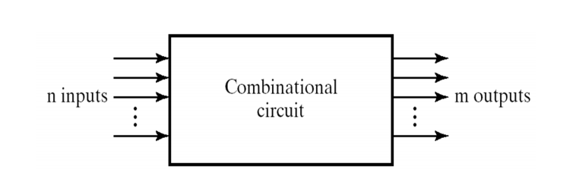
Hierarchical design of combinational circuits using logic modules
A combinational circuit consists of logic gates whose outputs at any time are determined by the current input values, i.e., it has no memory elements
Source : Wikipedia images

Slide 18
Hierarchical design of combinational circuits using logic modules
No complex circuit can be designed simply by interconnecting gates one at a time.
Divide and Conquer approach is used to deal with the complexity; 1.Break up the circuit into blocks
2.Define the functions and the interfaces of each block such that the circuit formed by interconnecting the blocks obeys the original circuit specification
3. If a block is still too large and complex to be designed as a single entity, it can be broken into smaller blocks

Slide 19
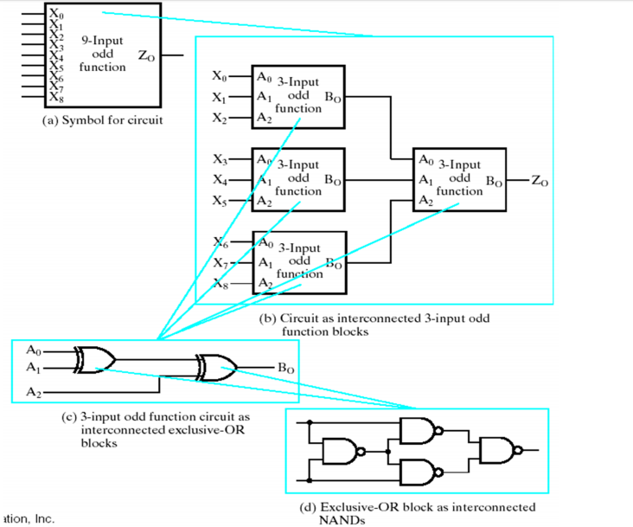
Illustration of divide and conquer methodology
Source :Google images

Slide 20
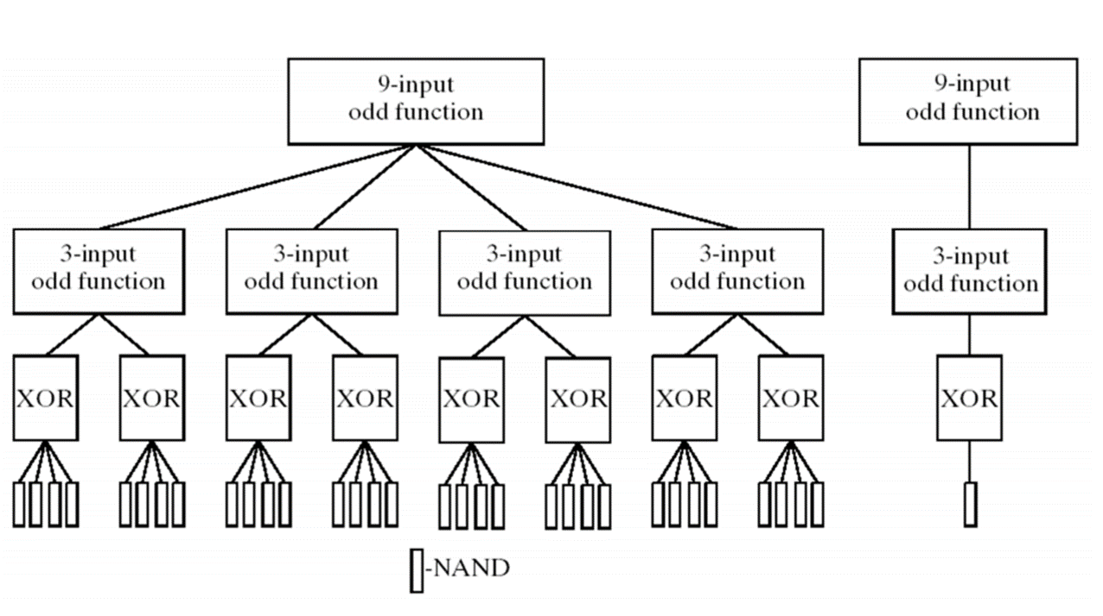
Hierarchical design due to divide and conquer
Source: http://infolab.stanford.edu

Slide 21
A hierarchy reduces the complexity required to represent the schematic diagram of a circuit.
The design of a combinational circuit involves the following steps: –
Specification: How the circuit operates is clearly expressed
Formulation: Derivation of the truth table or the Boolean equations that define the relationship between inputs and outputs
Optimization: Algebraic or K-map optimization of the truth table and draw the corresponding logic diagram
Technology Mapping: Transform the logic diagram to a new diagram using the available implementation technology
Verification: Verify the correctness of the final design

Slide 22
References
Ronald J. Tocci, Neal S. Widmer, Gregory L. Moss, Digital Systems , Principles and Applications, 10th Ed. , Chapter 9
Stephen Brown, Zvonko Vranesic, Fundamentals of Digital Logic with VHDL Design, 3rd Ed, Chapter 6

